Slide 1

Sync+ 2.0
CX727–Desay_EESE&CVPP parts
China EESE&CVPP
Updated on 2022-10-18
Desired Outcome
Awareness
Decision
Escalation Help
Think
Point of view
Plan to Implement
Implement

Slide 2
{R12 PRO HF5} Software overall status {yellow}
Software key info
  Refer SWAD for the details:
    MCU version: 20220915_528_PRO
    SOC version: 20221013_0809_CF15_R12.PRO.HF5_User
    Verification scope and method:
    {Full verification} executed with pass rate 98.87%, 0P1 and 13P2 issues found and not fixed. Refer test report for detail.
Main changes compared with previous version, refer RN for the details, highlights listed below:
    Release note – refer slide 3
    Open P2 issue list with risk evaluation – refer slide 4
    Performance status– refer slide 5-8
    OTA status– refer slide 9
Notes:
Add P1 weekly burn down chart

Slide 3
{R12 PRO HF5} 修改点
序号 | 描述 | 验证结果 | Comment
1 | 新功能：FAPA Voice Support | Pass | 在全功能自动泊车的使用过程中加入语音提醒和播报
2 | QQ Music VIP equity enhancement | Pass | 接入QQ音乐VIP曲库并增加相关功能（如：同步歌单、上次试听等）
3 | 360 Camera Enhancement（ODCV） | Pass | 前方雷达探测到障碍物自动激活前视360
4 | Easy Setting | Pass | 在下拉菜单增加充电设置功能。
5 | Face ID PCA Optimization | Pass | 如果登录时人脸识别失败，则默认登录上一个熄火时的账号。
6 | System Seting-Display 休眠重启后屏幕亮度为0 | Pass | 在VCS服务没起来时，未能接收到MCU发送的背光值。
7 | iphone 在连接paak时偶现断连问题 | Pass | 芯片固件问题（开窗事件太小），接收消息的时隙，时间太短。
8 | 车机打开媒体投射，手机搜索不到车机热点 | Pass | 上层增加loading状态，打开关闭严格根据底层状态刷新界面。
9 | 关闭媒体投射，手机端依然能搜索到此网络 | Pass | 在底层的回调里面关闭热点的，没有收到底层的回调，修改为同步关闭热点
Notes:
Add P1 weekly burn down chart

Slide 4

{R12 PRO HF5} Open P2 issue list with risk evaluation
Gating | Fix Version
13 | CF15_R13.PRO
Notes:
Add P1 weekly burn down chart

Slide 5
{R12 PRO HF5} 性能状态
R12.PRO.HF5性能优化点：
1.VPA动画开机静止100s，改善启动时cpu占用
2.优化删除多个APP的多余资源
3.优化radio、BT music、图库热起、温起时间
4.修改DLNA 后台播放时cpu 100%
Notes:
Add P1 weekly burn down chart

Slide 6
{R12 PRO HF5} 性能测试状态
序号 | 影响因素 | 权重 | R11得分 | R11数据 | R12得分 | R12数据 | R12 Target | 允许偏差上限 | 偏差 | Test Result | 分析
1 | Power on第一帧动画播放 | 1 | 4 | 7.047 | 4 | 7.084 | 7 | 8 | 1% | Pass
2 | Power on到Fast RVC显示 | 1 | 3 | 8.503 | 3 | 8.27233 | 6.50 | 7.5 | -3% | Pass | 测试case从power改成reboot存在2S偏差
3 | Power on Launcher界面可见 | 1 | 5 | 19.3677 | 5 | 19.7383 | 20.00 | 21 | 2% | Pass
4 | 开机阶段优先蓝牙重连完成 | 1 | 5 | 6.22367 | 5 | 7.59667 | 10.0 | 10.5 | 22% | Pass
5 | 开机阶段蓝牙音乐首次启动 | 1 | 0 | 2.68 | 5 | 1.04 | 2.00 | 2.4 | -56% | Pass
6 | 开机阶段FM首次启动 | 1 | 0 | 2.20 | 5 | 0.90 | 1.50 | 1.8 | -58% | Pass
7 | 开机阶段车机网络时间同步完成 | 0.5 | 5 | 16.478 | 5 | 15.69 |  |  | -5% | Pass
8 | Power on开机动画过程中到Fast RVC显示 | 1 | 0 | 0 | 4 | 1.306 | 1.20 | 1.44 |  | Pass
9 | 开机阶段Fast RVC显示 | 2 | 3 | 8.27 | 3 | 8.5 | 6.50 | 7.5 | -29% | Pass
10 | 开机阶段优先设备BT音源恢复 | 1 | 1 | 17.9923 | 4 | 8.861 | 8.00 | 9 | -51% | Pass
11 | 开机阶段到车辆设置界面打开 | 0.5 | 1 | 4.741 | 4 | 2.246 | 2.20 | 2.64 | -53% | Pass
12 | 开机阶段到空调设置界面打开 | 0.5 | 1 | 5.35 | 3 | 2.71 | 2.00 | 2.4 | -49% | Pass
13 | 开机阶段到快捷菜单上点击空调按钮可用 | 0.5 | 5 | 0.45 | 5 | 0.33 | 1 | 1.2 | -27% | Pass
14 | 开机阶段到SDM可用 | 0.5 | 3 | 6.50867 | 3 | 3.39067 | 3.30 | 3.795 | -48% | Pass
15 | Launcher显示到进入稳定运行阶段经过的时间 | 2 | 5 | 51.3093 | 5 | 40.9233 | 50.00 | 52.50 | -20% | Pass
16 | 系统稳定状态下Setting首次启动 | 0.5 | 5 | 1.44 | 5 | 1.066 | 1.40 | 1.68 | -26% | Pass
Notes:
Add P1 weekly burn down chart

Slide 7
{R12 PRO HF5} 性能测试状态
序号 | 影响因素 | 权重 | R11得分 | R11数据 | R12得分 | R12数据 | R12 Target | 允许偏差上限 | 偏差 | 偏差 | Test Result | 分析
17 | 系统稳定状态下蓝牙音乐首次启动 | 1 | 1 | 2.682 | 5 | 1.04 | 2.00 | 2.00 | 2.4 | -61% | Pass
18 | 系统稳定状态下FM首次启动 | 1 | 1 | 2.204 | 5 | 0.9 | 1.50 | 1.50 | 1.8 | -59% | Pass
19 | Setting热启动 | 1 | 3 | 0.77733 | 4 | 0.719 | 0.60 | 0.60 | 0.78 | -8% | Pass
20 | 蓝牙音乐热启动 | 1 | 5 | 0.67933 | 5 | 0.643 | 0.65 | 0.65 | 0.845 | -5% | Pass
21 | FM热启动 | 1 | 5 | 0.68 | 5 | 0.7 | 0.60 | 0.60 | 0.78 | 1% | Pass
22 | 图库冷启动时间 | 0.5 | 4 | 1.80733 | 5 | 0.76 | 1.00 | 1.00 | 1.2 | -58% | Pass
23 | 图库热启动时间 | 0.5 | 1 | 0.805 | 1 | 0.51 | 0.50 | 0.50 | 0.65 | -37% | Pass
24 | air conditioner热启动时间 | 0.5 | 1 | 1.11633 | 1 | 1.28733 | 1.10 | 1.10 | 1.32 | 15% | Pass
25 | 蓝牙电话开机恢复通话界面 | 0.5 | 1 | 15.93 | 4 | 9.62 | 10.00 | 10.00 | 10.5 | -40% | Pass
26 | 蓝牙电话冷启动时间 | 1 | 1 | 2.68 | 4 | 1.04 | 2.00 | 2.00 | 2.4 | -61% | Pass
27 | 蓝牙电话热启动时间 | 0.5 | 4 | 0.24 | 2 | 0.298 | 0.30 | 0.30 | 0.39 | 24% | Pass
28 | 投屏冷启动时间 | 0.5 | 5 | 1.07867 | 5 | 0.72 | 1.00 | 1.00 | 1.2 | -33% | Pass
29 | 精简屏幕冷启动时间 | 0.5 | 5 | 0.91067 | 5 | 0.89 | 1.00 | 1.00 | 1.2 | -2% | Pass
30 | 精简屏幕热启动时间 | 0.5 | 1 | 0.70767 | 1 | 0.63333 | 0.70 | 0.70 | 0.91 | -11% | Pass
 | 得分 |  | 71 |  | 103.5
Notes:
Add P1 weekly burn down chart

Slide 8
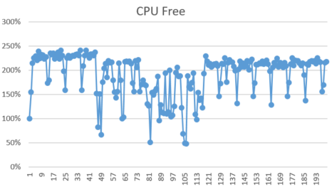
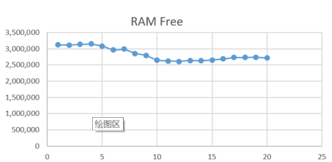
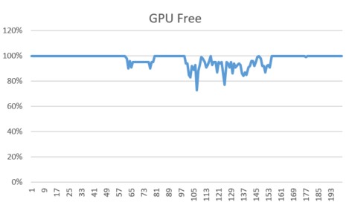
{R12 PRO HF5} 性能状态
序号 | 影响因素 | SPEC | Reference | R12.HF4 | Test result | 分析
1 | 24小时Monkey测试中的CPU Free | 1 |  | 1.91 | Pass
2 | 24小时Monkey测试中的RAM Free | 1 |  | 2,833,870K | Pass
3 | 24小时Monkey测试中的GPU Free | 1 |  | 0.97 | Pass
4 | 24小时Monkey中的ANR次数 | 1 |  | 0 | Pass
5 | 24小时Monkey中的Crash次数 | 1 |  | 0 | Pass
6 | 24小时Monkey中内存泄露进程数 | 1 |  | 0 | Pass
7 | 8小时Monkey测试-设置 | 0.5 |  | 0 | Pass
8 | 8小时Monkey测试-蓝牙音乐 | 0.5 |  | 0 | Pass
9 | 8小时Monkey测试-蓝牙电话 | 0.5 |  | 0 | Pass
10 | 8小时Monkey测试（其他所属应用） | 0.5 |  | 0 | Pass
CPU Free
RAM Free
GPU Free
Notes:
Add P1 weekly burn down chart

Slide 9
{R12 PRO HF5} OTA测试状态
Title: | Verification Test Report For OTA
Function Name | Total Test Case | Passed Test Case | Failed Test Case | Percentage of Test Completion: | Test Cases Pass Percentage:
TC_SOC_OTA | 83 | 78 | 0 | 93.98% | 100.00%
TC_MCU_OTA | 69 | 68 | 0 | 98.55% | 100.00%
TC_MCU_USB | 63 | 62 | 0 | 98.41% | 100.00%
TC_SOC_USB | 63 | 62 | 0 | 98.41% | 100.00%
Total | 278 | 270 | 0 | 97.12% | 100.00%
Test Summary Description
Notes:
Add P1 weekly burn down chart

